Slide 1
SPINAL DYSRAPHism evaluation and management

Slide 2
Spinal dysraphism: classification
Spinal dysraphism : Group of congenital abnormalities resulting from defective closure of the neural tube in the spinal region of neuraxis
Encompasses all forms of spina bifida
Classified into
  Spina bifida aperta : Open communication of NT with environment
  Spina bifida cystica : Myelomeningoceles
  Spina bifida occulta : Covered with normally developed skin.

Slide 3
Myelomeningoceles
Disorder resulting from defective primary neurulation
Incidence
  0.4 per 1000 live births
  Racially variable
85% caudal thoraco lumbar spine, 10 % in the thorax and the rest cervical
80-90 % associated with hydrocephalus and Chiari

Slide 4
Myelomeningoceles
Neurological deterioration can occur
  Symptomatic HCP or Chiari-II
  Hydrosyringomyelia
  Retethering of cord
  Mostly due to hydrocephalus from shunt malfunction

Slide 5
Risk Factors for NTD
Risk factors | Risk %
Previous pregnancy with NTD | 2-3%
Partner with NTD | 2-3%
Diabetes mellitus type 1 | 1 %
Seizure disorder | 1 %
Close relative with NTD | 0.3-1 %
Post pregnancy obesity | 0.2%

Slide 6
Risk Factors for NTD
Agricultural pesticides and chemicals
Cleaning solvents and disinfectants
Nursing
Radiation
Anesthetic agents
Hot tubs, saunas and fever (hyperthermia)
Lead
Tobacco smoke

Slide 7
Recommendations for dietary Folate supplementation
Circumstance | Dose
Before pregnancy
Women with no risk factors | 0.4 mg/ day
Women at high risk | 4 mg day
During pregnancy
Women with no risk factors | 0.6 mg /day
Women at high risk | 4mg /day
Post partum with breast feeding
Women with no risk factors | 0. 5 mg /day
Women at high risk | 4mg /day

Slide 8
Prenatal Diagnosis
  Maternal serum Alpha feto protein : initial screening test
  High resolution Fetal Ultrasonography.
    Can also demonstrate hydrocephalus and Chiari-II abnormality (Lemon and Banana sign)
  Amniocentesis : if MSAFP and USG are suggestive
    Ach esterase levels along with AFP
  AFP can increase in other developmental anomalies of the gut and kidneys.

Slide 9
Preop evaluation
General
  Repaired within 72 hrs
  Enteral feeding avoided to prevent fecal soiling of placode
  Prone position, saline dressings
Neurosurgical
  Sensory level determined
  Motor evaluation – Distal most voluntary motion evaluated. Limb abnormalities documented.
  Anal tone and anal reflex evaluated

Slide 10
Preop evaluation
Ventricular size documented with preop USG and NCCT head.
Observe for symptoms of Chiari II
Renal evaluation
  90 % have neurogenic bladder.
  All should have preop Renal ultrasound for detecting severe anomalies.
  CIC if fails to void.

Slide 11
MMC repair
Timing
  Within 72 hrs
  Delayed repair – high risk of meningitis/ ventriculitis/ shunt infection. Mortality 13 %
    Obtain placode culture
  VP shunt placement along with MMC repair recommended if e/o HCP at birth

Slide 12
MMC repair
Surgical procedure
  Patient positioned prone
  Contact of Povidone iodine solution with neural placode to be avoided.
  Goal of surgery
    Protect the functional tissue in the neural placode
    Prevent CSF loss
    Minimize risk of meningitis by reconstructing neural tube and coverings

Slide 13
Post op care
Per- operative antibiotics
Prevention of fecal contamination of wound
Nurse in Trendlenberg’s
Observe for HCP – shunt if HCP present
Complications
  Superficial wound dehiscence
  Meningitis
Symptomatic Chiari
  Ensure functioning shunt
  Hindbrain decompression

Slide 14
Occult spinal dysraphism
Congenital spinal defects covered by intact skin
Causative lesions
  Fatty filum terminale
  Lipomyelomeningocele
  Split cord malformations type I and II
  Inclusion lesions (dermoid, dermal sinus tract)
  Neurenteric cyst
  Myelocystocele

Slide 15
Manifestations of occult spinal dysraphism
Cutaneous stigmata | Orthopedic deformities | Urologic problems
Asymmetric gluteal cleft | Foot or leg deformities | Neurogenic bladder
Capillary hemangioma | Scoliosis | UTIs
Subcutaneous lipomas | Sacral agenesis | Incontinence
Hypertrichosis |  | Delay in toilet training
Dermal sinus tract
Cutis aplasia

Slide 16
Neurological signs and symptoms in different age groups
Infants | Toddler | Older children | Young adults
Decreased spontaneous leg movements | Delayed walking | Asymmetric motor/ sensory development | Back pain
Absent reflexes | Abnormal gait | Back/leg pain | Leg cramping/pain
Leg atrophy |  | UMN signs | Spasticity
Foot asymmetry |  | Painless ulceration | Hyperreflexia
Decreased urinary stream |  |  | Bowel/bladder incontinence.

Slide 17
Plain radiological findings
Structure | Findings
Lamina | Fusion defects,midline defects,abnormal spinous processes
Vertebral bodies | Hemivertebrae,Butterfly vertebrae,Block vertebrae,Midline cleft defects, canal stenosis
Disk space | Congenital narrowing
Pedicles | Flattening, thinning
Widening of spinal canal | Interpedicular widening, scalloping of posterior border, Midline bony spur.
Failure of development | Reduced number of vertebral bodies, Absence of parts of vertebrae, sacral dysjunction
Spinal curvature | Scoliosis, kyphosis, lordosis.

Slide 18
Lipomyelomeningoceles
  Lipoma tethering the cord to the subcutaneous tissue
  Fascial, spinous and dural defect
  Lipoma cord interface distracted out of the spinal canal by traction created by tethering

Slide 19
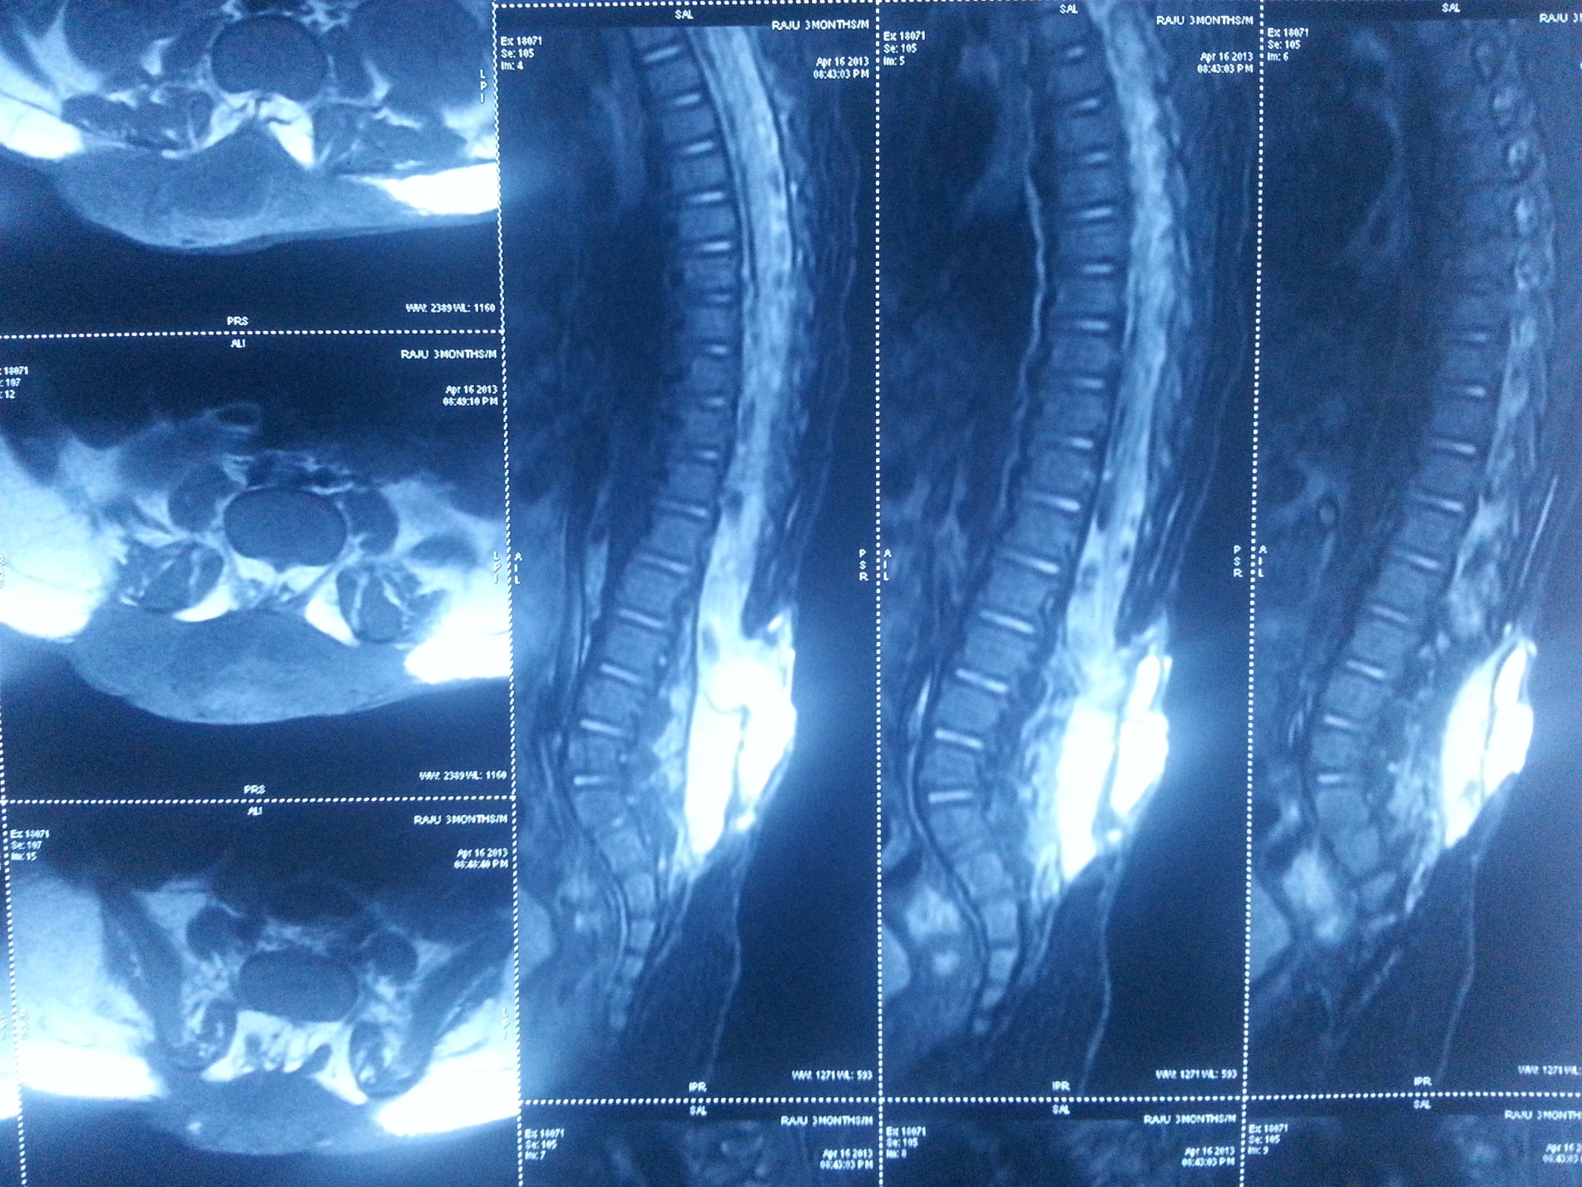
MRI images of lipomyelomeningocele

Slide 20
Classification
  Type I ( Dorsal lipoma)
  Type II ( Transitional lipoma)
  Type III ( Terminal lipoma)

Slide 21
Dorsal lipoma ( Type I)
  Fibrolipomatous stalk tethering cord proximal to conus
  Usually at middle lumbar to lumbo sacral level
  Dorsal spinal cord dysraphic at site of attachment of lipoma
  Site of attachment medial to the dorsal root entry
  Normal spinal cord distal to myeloschisis.
  Roots lie within the subarachnoid space.

Slide 22
Caudal or terminal lipomas (Type III)
  Directly from conus medullaris or filum terminale
  Largely or wholly intradural
  Nerve roots entangled in the lipoma
  Lipoma cord interface caudal to the dorsal root entry zone.
  Filum may be fatty, thickened and sometimes attached to subcutaneous tissue ( sacral dimple).

Slide 23
Transitional lipomas
  Share the characteristics of both Type 1 and type 2.
  No normal spinal cord distal to lipoma attachment
  Initially dorsal roots may be separate but caudally become enmeshed into the lipoma.
  Frequently asymmetric attachment to cord.

Slide 24
Abnormal embryology LMMC
Usually a disjunction in timing of neural tube closure and cutaneous ectoderm closure
Elements of the ectoderm become incorporated into the incompletely closed neural tube.

Slide 25
Clinical features
Subcutaneous masses over the back
Stigmata of occult dysraphism
  Hypertrichosis
  Hemangioma
  Hypo/ hyperpigmented patch
  Dermal pit or sinus
  Atretic meningocele
  Asymmetric gluteal cleft

Slide 26
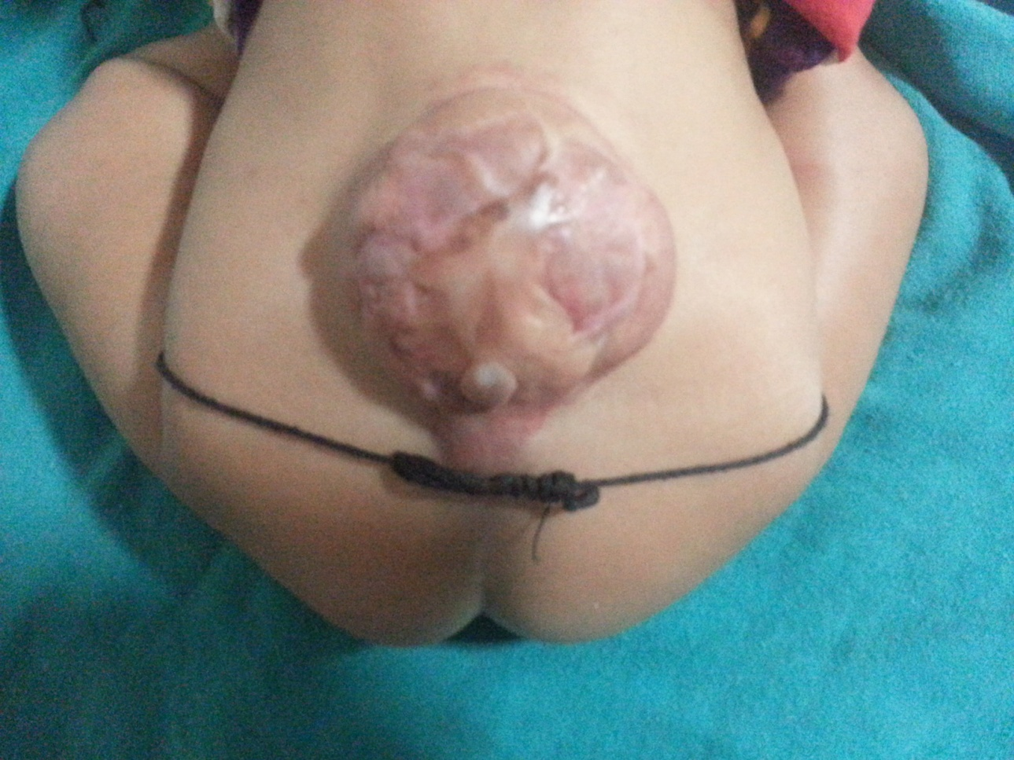
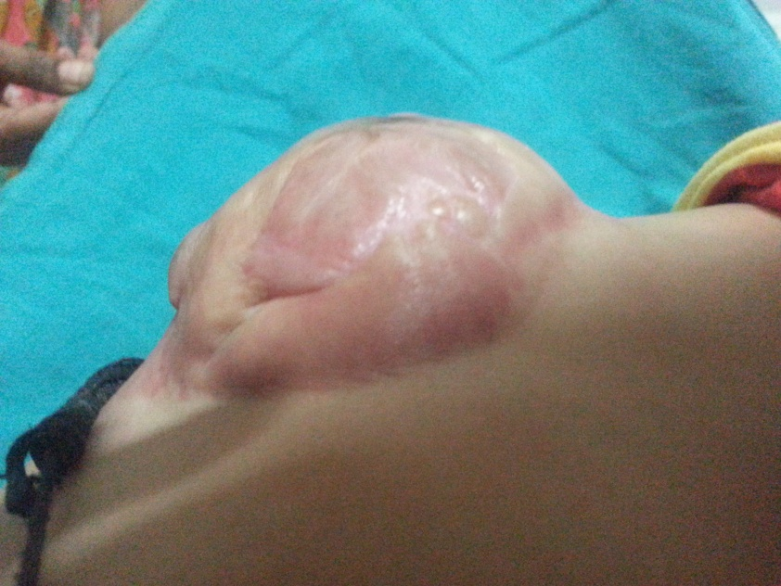
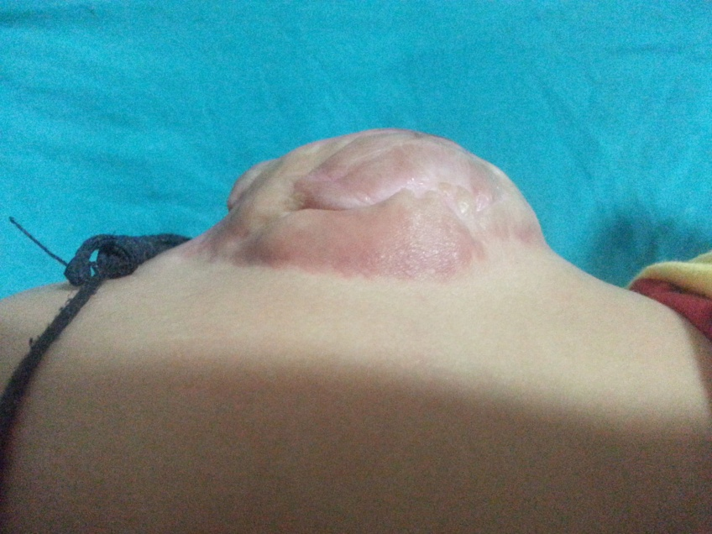

Slide 27
Inexorable symptomatic progression seen in untreated cases
Risk of precipitous neurologic deterioration
  Orthopedic syndrome
    Limb length discrepancy, high pedal arches, hammer toes, calcaneovarus/ valgus foot deformity.
  Urologic syndrome
    Urinary incontinence, post void dribbling, urgency, frequency
  Intractable pain in the legs, back, pelvis or perineum.

Slide 28
Indication for surgical repair
Asymptomatic infant older than 2 months
Presence of orthopedic, pain or urologic syndrome
Neurological symptoms
Prior to corrective spinal surgery.

Slide 29
.
Goals of surgery
  Detethering of spinal cord
  Decompression of the cord by removing as much lipoma as possible
  Preservation of the functional tissue
Surgical principles
  Relationship between the lipoma-cord interface and dorsal roots to be established
  Conservative excision of the lipoma to avoid injury to the cord/ exiting roots.

Slide 30
Complications of surgical repair
  Early – CSF leak/ pseudomeningoceles
  Late – retethering of the cord
    Mostly presenting between 3-8, 11-22 months after surgery
    Upto 20% cases may demonstrate retethering
    Diagnosis primarily clinical.

Slide 31
Lipoma of the terminal filum
Less severe form of OSD
More than 2 mm thickness of the filum on MR imaging
Frequently associated with sacral/gluteal cleft dimples.
May be associated with VATER association, imperforate anus, cloacal extrophy and other urogenital abnormalities.
Sometimes a/w sacral agenesis
Reflects defective secondary neurulation

Slide 32
Clinical presentation
  Orthopedic
  Urologic
  Pain
All asymptomatic infants and symptomatic adults are surgical candidates.
Surgical procedure is the exposure of filum through lumbosacral laminectomy or interlaminar approach
  The filum identified separated from nerve roots and cut.

Slide 33
Split cord malformation
Longitudinal developmental splitting of the cord over one or multiple levels
Type I split –separate dural sheaths for the two hemicords separated by intervening osseous/ fibrocartilaginous septum.
Type II split – single dural sheath, hemicords separated by fibrotic bands.
Both types may be present simultaneously at different levels

Slide 34
SCM more common in females (M:F=1:3)
Average age of presentation is 4-6.5 years
Cutaneous stigmata most specifically hairy patch
Orthopedic deformities including scoliosis also commonly seen
Clinical course similar to other patients with tethering of spinal cord.

Slide 35
In Type I – Bony septum prevents ascent of spinal cord
In Type II – Fibrous bands tether the cord to the dural sheath
Coexistent neuroepithelial cysts, lipomas, dermoids and syrinxes

Slide 36
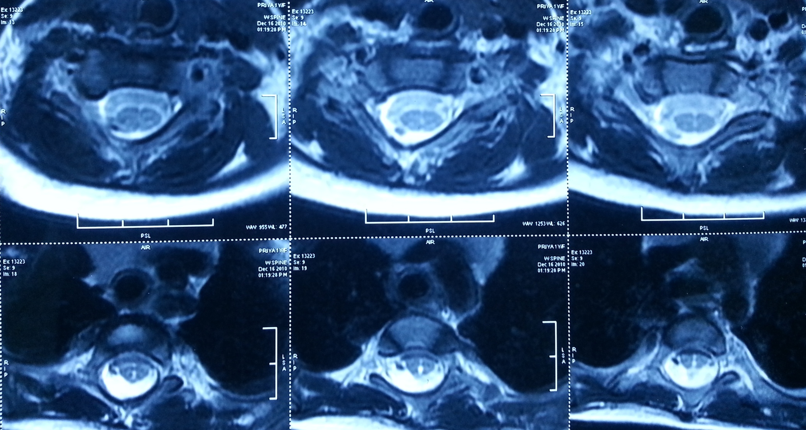

Slide 37
Operative management
  Surgical detethering of cord by excision of the bony spur/ division of the fibrous bands
  Caution exercised to avoid damage to the hemicords during excision of the spur.
  Type I split further classified into A- D types (Gupta et al Pediatric neurosurg 2006,42, 341-46)
      Location of the bony spur
      Free space available around it
      Correlating with complexity of surgical repair.

Slide 38
Neurenteric cysts
Persistent neurenteric canal communicating between yolk sac and amniotic cavity
Intradural, extramedullary mucosa lined cysts
Formed from persistent tracts communicating with respiratory and gut epithelia.
Associated with vertebral anomalies
MRI- demonstrates non- contrast enhancing intradural extramedullary cyst

Slide 39
Presentation usually in late years (50-60 years)
May also present in pediatric age group
Most common location is cervico- thoracic
Usually postero-lateral surgical approach
Complete excision of cyst – long term symptom free survival.

Slide 40
Dermal sinus tracts
Abnormal tracts communicating between the skin and intraspinal compartment.
Most common- lumbosacral location
May occur anywhere from nasion to coccyx in midline
May be accompanied by other cutaneous stigmata.
Tract terminates within thecal sac mostly
Half may have associated dermoids, epidermoids, teratoma at termination.

Slide 41
Potential pathway for spread of infection
Repeated episodes of meningitis with atypical organisms
Operative repair consists of complete excision of the track under prophylactic antibiotic cover.
Gram positive and gram negative coverage

Slide 42
Meningoceles
Distinguished from MMCs by absence of hydrocephalus , Chiari malformation or lower limb abnormalities
Dural defect through with CSF space and meninges herniate.
Concomitant neurocutaneous lesions such as lipomas, dermal sinus tracts may cause tethering
Surgical repair of defect at 4-6 months of age.

Slide 43
Anterior meningoceles
  Herniation of meninges and CSF in ventral location
  Commonly in presacral and lumbosacral region
  Female predominance
  Currarino’s triad- anorectal abnormalities, presacral mass, sacral bony abnormalities.
  Presacral tumor may be epidermoid, dermoid or teratoma
  Meningitis by atypical organisms may also occur.
  Posterior surgical approach to repair the dural defect and dether the cord.

Slide 44
Myelocystoceles
Terminal dilatation of the central canal that herniates through defective posterior elements
Expanded spinal cord, CSF, fibrous bands and meninges and lipomatous elements
Result from disordered development of the caudal cell mass
Associated anomalies of the anorectal system, lower GI tract and spinal column

Slide 45
Myelocystoceles
Surgical repair attempted because of the resultant tethering of spinal cord.
Repair within 6 months
Per-op trumpet shaped distended conus often adheres to the superficial fat
Detethering may be difficult.

Slide 46
Thank you

